Slide 1
Predicting House Prices with Machine Learning
Zach, Avani, Joe & Tiger
Notes:
Tiger:

Slide 2
Introduction
This project was focused on looking at key parameters which may help determine Home Values
Start with Charlotte, and proceeded to include 9 other cities based on City size (avoid bias in data).
Charlotte, NC
Boston, MA
Atlanta, GA
Chicago IL
Portland, OR
Williamsburg, VA
Cookeville, TN
Waterloo, IA
St Augustine, FL
Santa Fe, NM

Slide 3
Data Extraction, Transformation & Loading
Utilized Quandl and pulled Zillow historical data dating back 25 years (for most cities).
Pulled separate JSON files for each city and converted to CSV files.
Uploaded the csv files into MongoDB into one database.

Slide 4
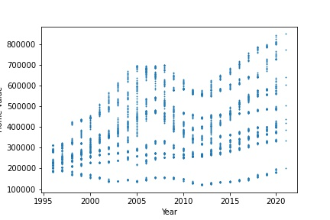
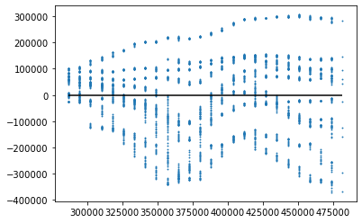
All cities
Home Values
Variability
Home Values
Found statistics and predictions for entire data
Housing R2 Score: 0.125
Plot of residuals at various price points shows HUGE Variability.
Notes:
1995 to 2020 data Trend of home values over time → poor correlation and the residual chart shows a lot of variability at all price points. An example is looking at 300k home values u would expect to pay + or - 150k and as it gets higher in home prices the variability is even more spread

Slide 5
Lets look at individual cities...
Using several cities (as a substitute for nationwide statistics) is not helpful.
Created separate data frames for each city
Created scatter/ linear regression / residuals plots for each city.
Notes:
Cannot use nationwide statistics

Slide 6
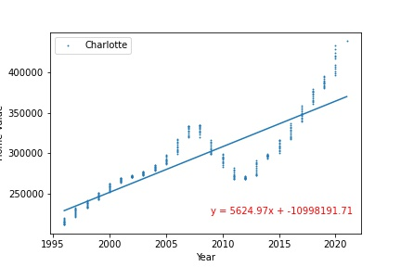
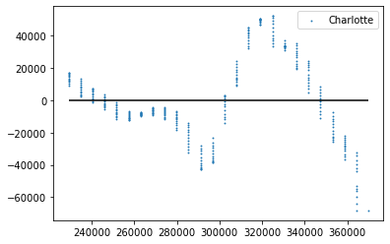
Charlotte
Home Values
Variability
Home Values
Housing R2 Score: -33.376 (pre-recession and recent exponential trends!)
Residuals: High variability at all Price Points
Notes:
Avani

Slide 7
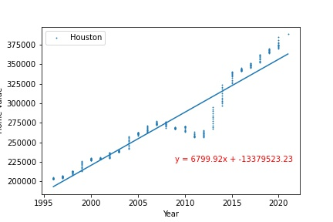
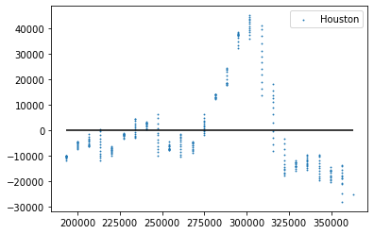
Houston
Home Values
Variability
Home Values
Housing R2 Score: 0.902
Residuals: Variability around 300k budget (upto $40k), but otherwise less than $10k
Notes:
Avani

Slide 8
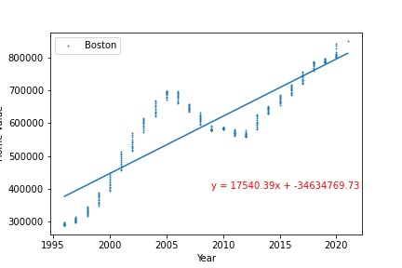
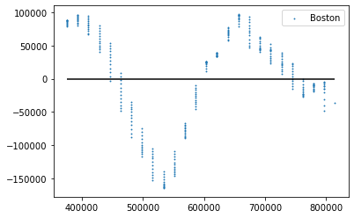
Boston
Home Values
Variability
Home Values
Housing R2 Score: 0.753
Residuals: High Variability in data at all Price points
Notes:
Avani

Slide 9
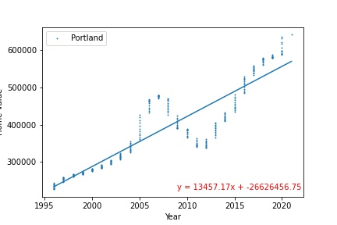
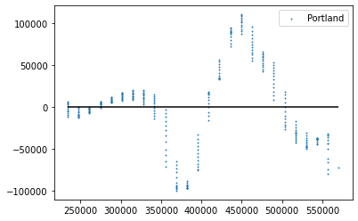
Portland
Home Values
Variability
Home Values
Housing R2 Score: 0.798
Residuals: High variability in homes >350k
Notes:
Avani

Slide 10
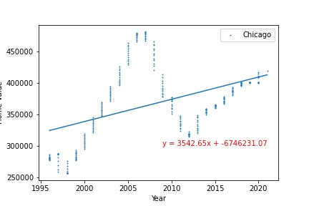
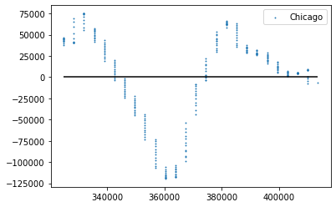
Chicago
Home Values
Variability
Home Values
Housing R2 Score: 0.191
Residuals: High Variability in data at all Price points
Notes:
Avani

Slide 11
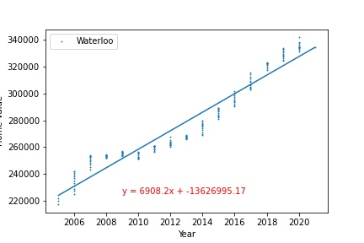
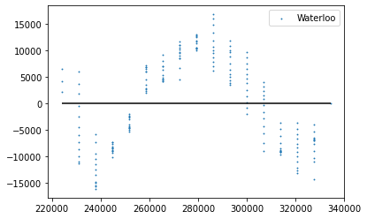
Waterloo
Home Values
Variability
Home Values
Housing R2 Score: 0.931
Residuals: Low variability at all Price Points
Notes:
Avani

Slide 12
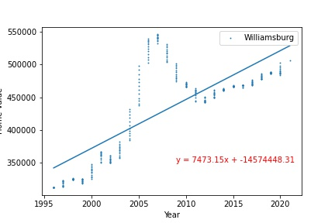
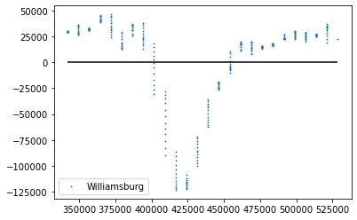
Williamsburg
Variability
Home Values
Home Values
Housing R2 Score: -3.629 (pre-recession exponential trend!)
Residuals: High variability around $425k, otherwise fairly low variability
Notes:
Avani

Slide 13
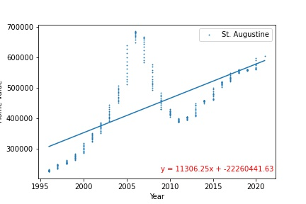
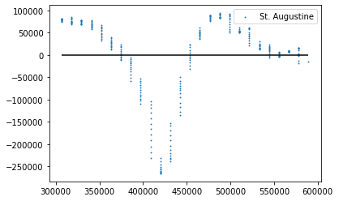
St. Augustine
Variability
Home Values
Home Values
Housing R2 Score: 0.450
Residuals: Extremely High Variability at all Price Points (minor exception at >500k)
Notes:
Avani

Slide 14
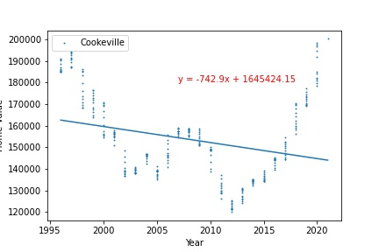
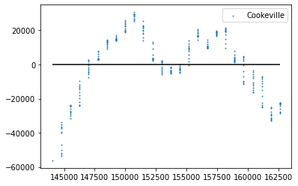
Cookeville
Home Values
Variability
Home Values
Housing R2 Score: 0.0783 (other phenomenon not explained by recession volatility)
Residuals: High Variability at all Price Points
Notes:
Avani

Slide 15
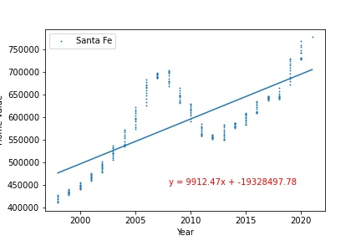
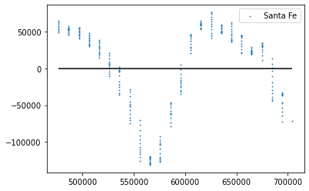
Santa Fe
Home Values
Variability
Home Values
Housing R2 Score: 0.558 (pre-recession and recent exponential trends!)
Residuals: High Variability at all Price Points
Notes:
Avani

Slide 16
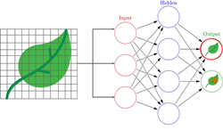
Testing the Accuracy and Validity of our Trained Model Using Artificial Neural Networks (ANN):
OBJECTIVE: Avoid Overfitting
Used dataset for home values of all Cities analysed
Data split - training and validation sets
Main dependencies used
Keras
Sklearn
Pandas
Google Colab Notebook
Notes:
Joe

Slide 17
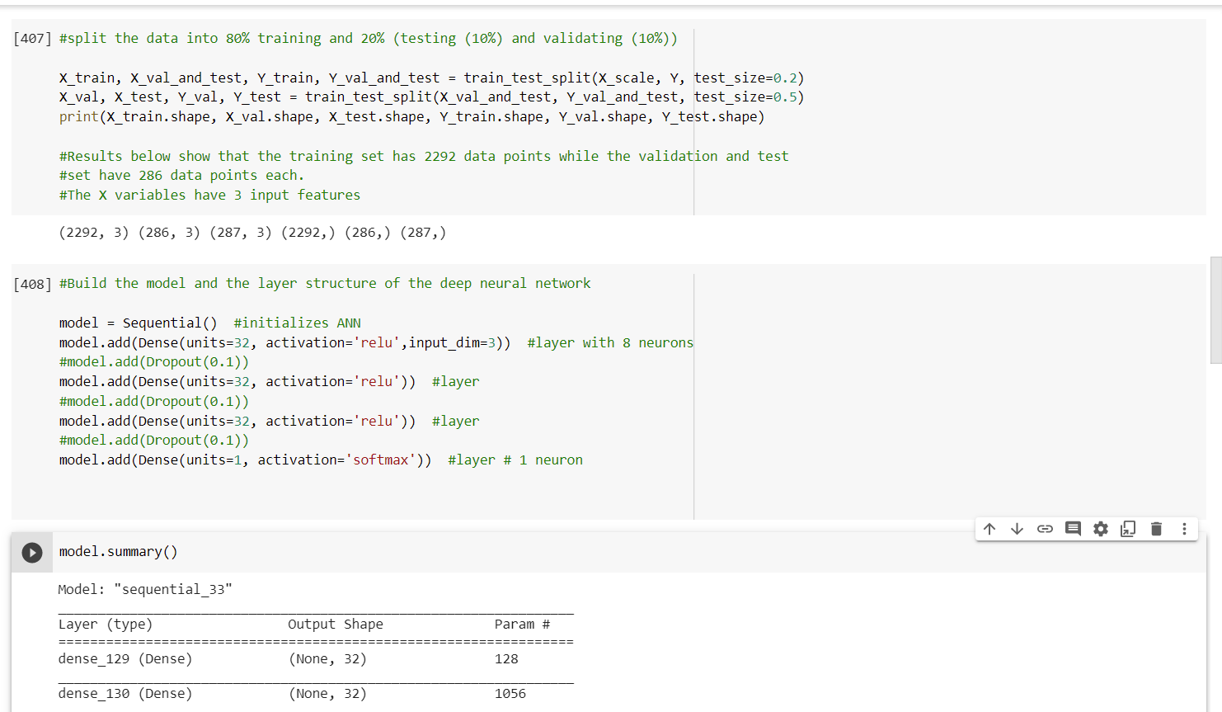
Data sets splitting, and
Building Layer structure for ANN layers.
Notes:
Joe

Slide 18
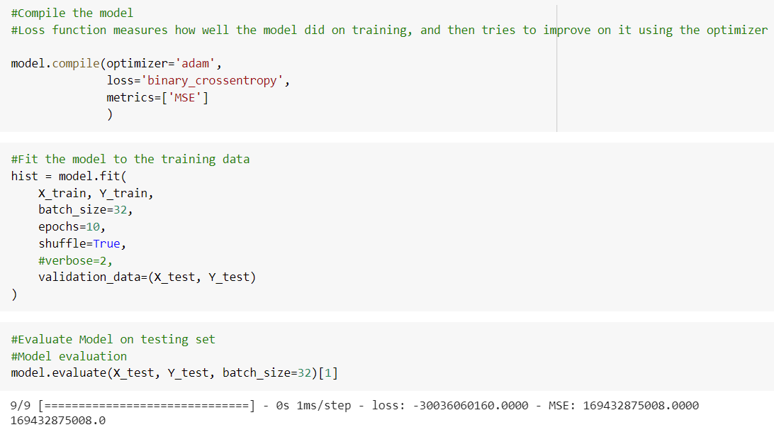
Model compilation and data fitting
Notes:
Joe

Slide 19
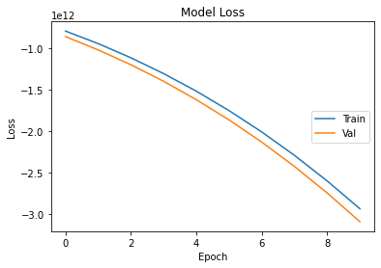
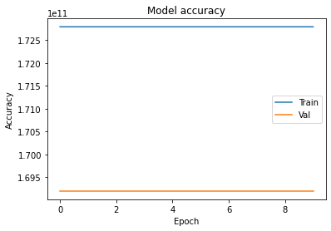
Loss & Accuracy Validity check for Overfitting
After the Training loss/Validity loss and Training accuracy/Validity accuracy tests, the model does not show any overfitting. The loss has a downward trajectory. Accuracy and Validity is confirmed for this model.
Notes:
Joe

Slide 20
Tableau
Utilized Tableau for visualization and prediction of Home Value for each city over next 5 years (2025)
https://public.tableau.com/profile/zachary.cohen4578#!/vizhome/FinalProject3Updated2/Dashboard1?publish=yes
Notes:
Zach

Slide 21
Conclusions
Analysis of nearly 25 years of data for 10 cities shows:
Using multiple cities (ie. Nationwide statistics) as proxy for specific cities NOT recommended
Using other similar size cities as proxy may work in certain cases.
Trends in individual smaller cities are unique and warrant focused approach
Prices in certain cities (Big and small) show variability at ALL Price Points whereas some cities (big or small) shows variability only at higher price points.
Also,
Accuracy and Validity of the Model CONFIRMED!
Margin of Error of Average Projected (2025) Home values, is representative of the R2 Score.
A majority of the studied cities are projected to have increase in home values over next 5 years.
Notes:
Zach

